Slide 1
Our Tools
Capitalisation Assessment Interviews
Notes:
Hello,
Today I am going to tell you about an essential tool that is used when capitalising on an experience or activity: the assessment interview.

Slide 2
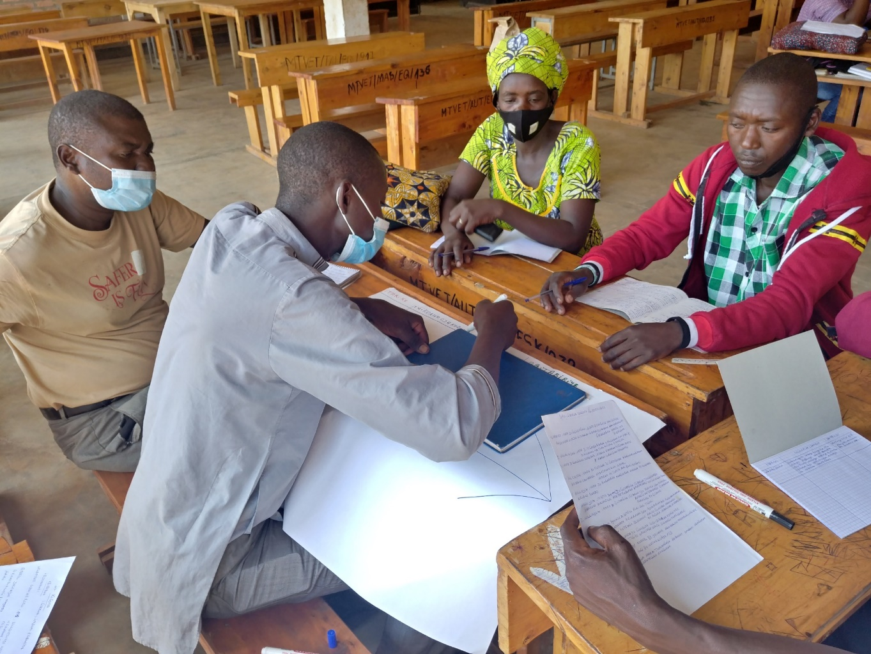
Interviews are useful capitalisation tools.
Other tools can help you gather information, such as : Brainstorming workshops, Surveys, etc.
A brainstorming workshop
Notes:
First of all, it is important to say that capitalisation interviews are a good tool, but other activities should also be used to get other information: for example, surveys or brainstorming workshops (as shown in the photo).

Slide 3
Choosing the right people
Notes:
The first step in the interview process is the identification of the people who will be your interviewees.

Slide 4
The aim of capitalisation is to "move from experience to shareable knowledge "*.
Interview people with different perspectives on the experience.
In the case of collective action: interview various actors.
*Pierre de Zutter, Des histoires, des savoirs, des hommes : l’expérience est un capital, 1994.
Notes:
Let's remember that capitalisation means moving from an experience to shareable knowledge. It is therefore useful to interview people who played different roles in the experience. In the case of a collective action - i.e. an action involving several groups of agents, it is paramount to interview people from these different groups.

Slide 5
The interviewees must have relevant and exhaustive opinion and experience of the experience you want to capitalise.
Notes:
For efficiency, it is also important to contact people who played a key role so that they can provide full information.

Slide 6
Setting up an ITW Guide
Notes:
Once the people who need to be interviewed have been identified, an interview guide will be set up.

Slide 7
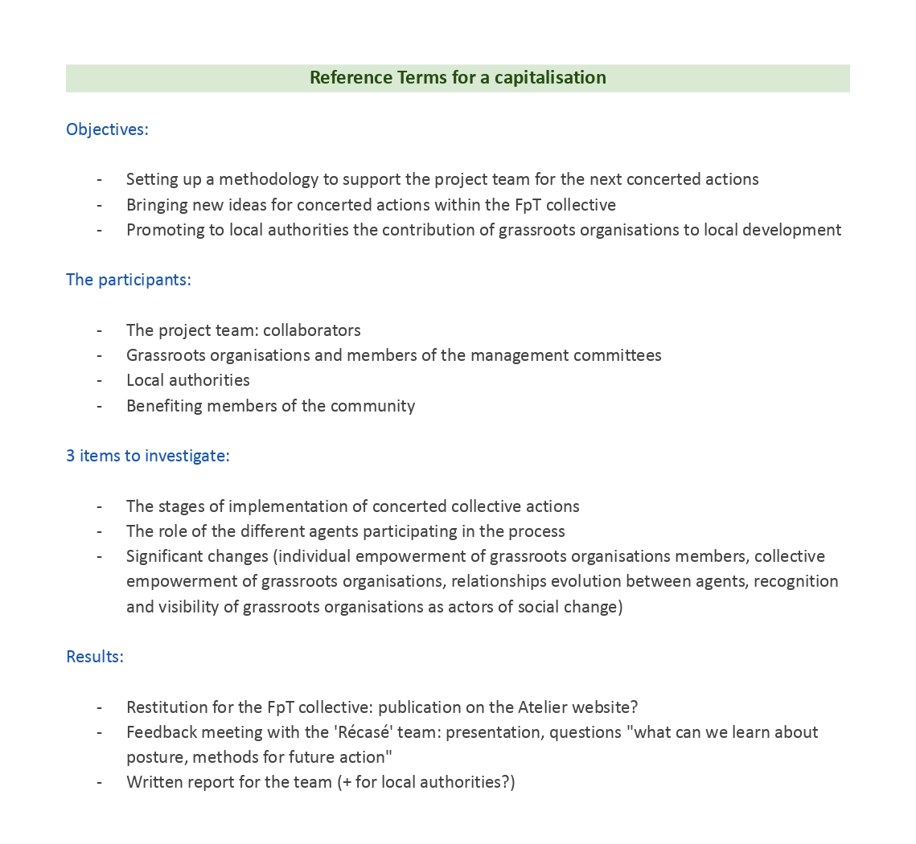
The interview guide is based on the Terms of Reference for the capitalisation.
It should highlight the relevant informations.
Terms of reference for a capitalization by the 'Récasé' project
Notes:
Prior to capitalisation, terms of reference have been drawn up. These must be taken into account in order to design an interview guide that is relevant to the information you are looking for.
For example, in the case of a collaborative work camp with several agents, if we want to know how the agents worked together, it is useless to spend too much time asking the participants about the financial management of this action.

Slide 8
Go for open-ended questions to encourage people to speak.
While it is important to adapt the interview guides to each agent, you also need to have common questions.
Notes:
The questions asked should be open-ended and not inspire a yes or no answer.
The interview guides will be different for each agent. However, key questions should be asked to everyone in order to draw out different experiences.

Slide 9
Capitalisation ≠ Survey : The guide is not set forever, it can evolve.
You can change the wording, but not the content or topic of the question.
Notes:
Capitalisation is not a survey or a statistical study: the wording of questions may vary from one interview to another until we can get an answer, but the meaning of the question should not change.

Slide 10
The Interview
Notes:
Now, let's talk about the actual interview.

Slide 11
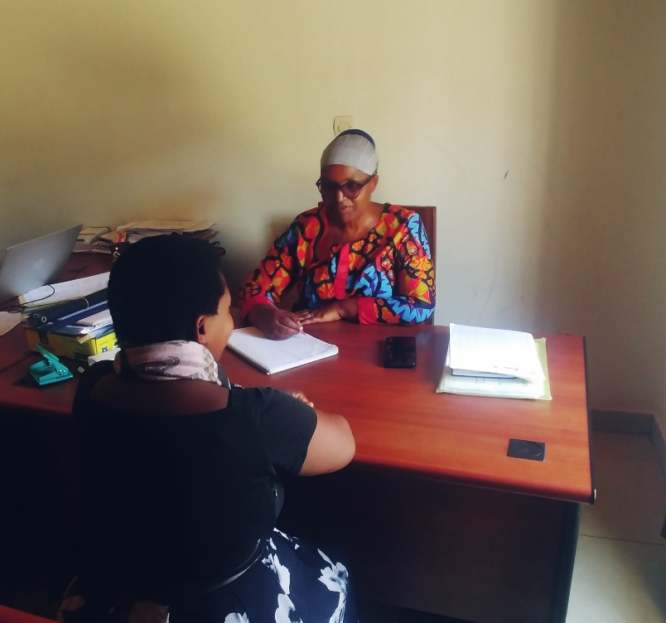
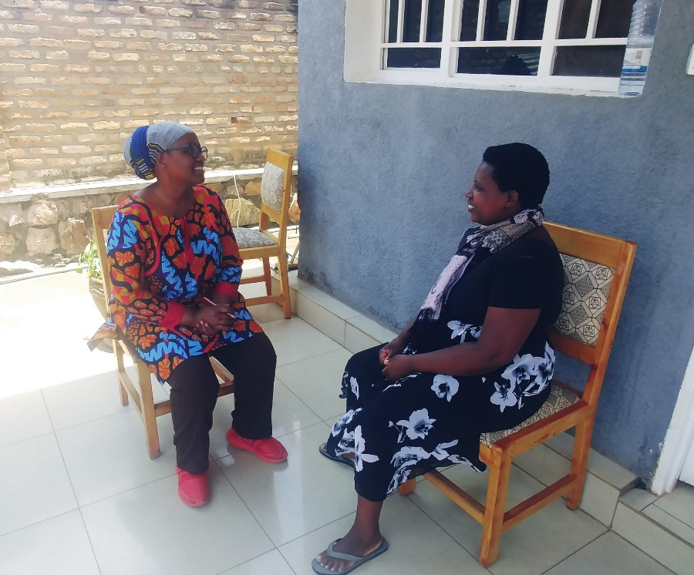
Set the interview in a familiar environment for the person.
Avoid sitting face-to-face. Choose a natural conversational posture.
Notes:
It is always more pleasant for the person to have the interview in a familiar environment, rather than in an office.
Also, this is not a job interview: no reason to face the person, but rather to adopt a natural discussion posture.

Slide 12
Follow the interview guide.
Do not hesitate to rephrase the questions.
Skip a question if you realise the person can't answer it.
Notes:
Although capitalisation favors debate, it is important to follow the interview guide. During interviews, we often notice a deviation that does not provide the information we are looking for. Rephrasing or clarifying questions is often useful.
Sometimes it may be necessary to skip some questions if it is clear that the person does not understand the subject. Though, if the person is unable to answer too many questions, it may affect their self-esteem.

Slide 13
Handling the Interview
Writing, sound recording, video, … : depending on available resources and your preferences.
When processing the interview, collect the testimonies and compare the answers given to the same question/topic.
Notes:
The interviews can be based on notes, audio recordings or even a video.
To process the interview, all the statements are collected and then the different answers given to the same question or topic are analysed.

